Slide 1

Web Programming Final Pitch
Team: Matei Moldoveanu, Angelo Saez, Zachary Scarpati, Steven Vazquez

Slide 2


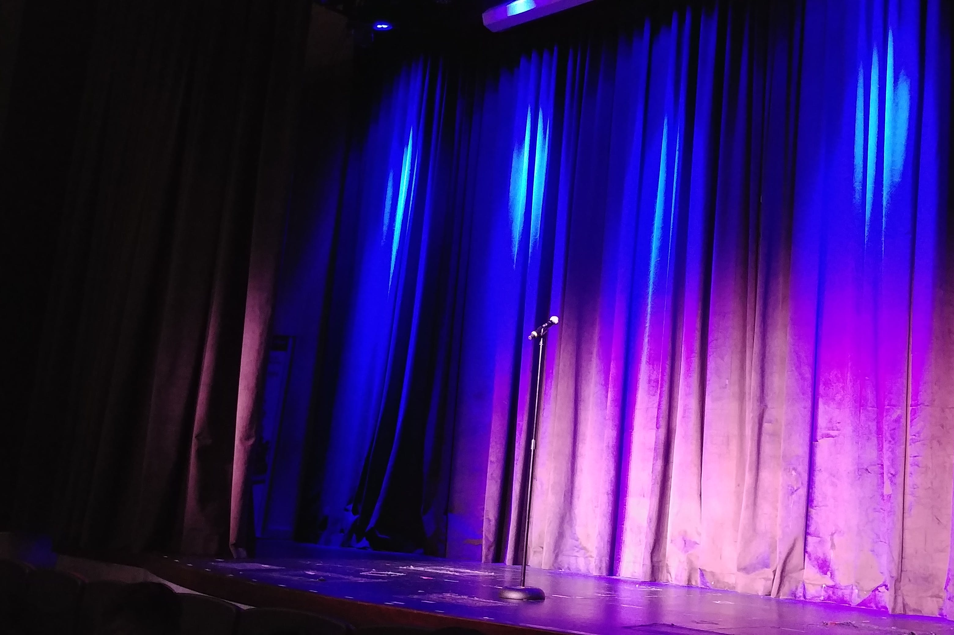
Application Introduction and Description
Imagine you have an undying, forever burning passion for words whether its prose or non-fiction, an article or a short story. Perhaps you are a novice novelist looking to gain feedback or engage with like minded individuals? Are you hungry to write? Do you crave feedback? Do you love literature of all varieties? Do you want to gather with other creators and artists alike? If any of these questions or possibilities peak your interest, then look no further! Our site will provide a platform for lovers of words to flourish. If you are a writer, your words will have the opportunity to be read by minds with a common love for literature.

Slide 3
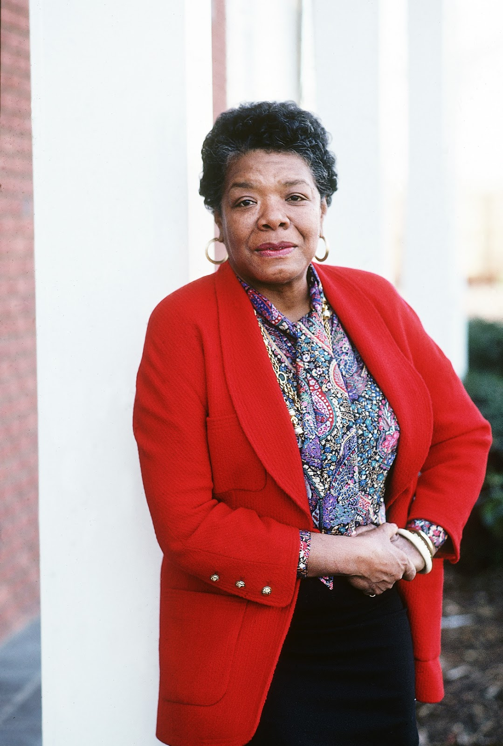
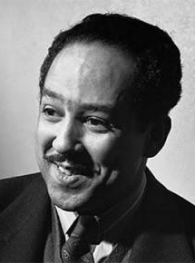

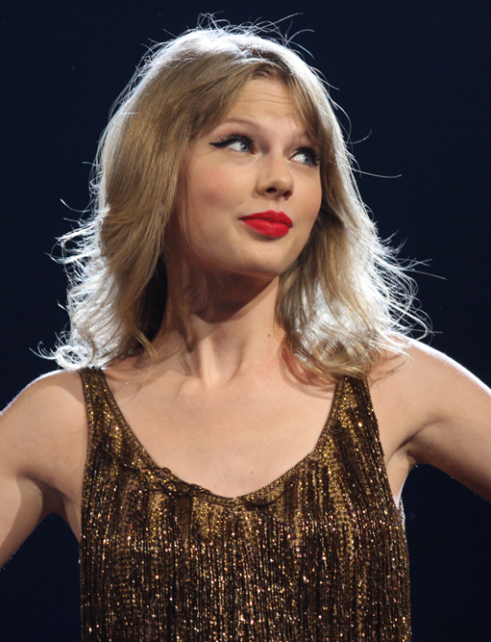
Target User
Our target user is anyone with a passion for words. Whether you’re a journalist, poet, novelist, song or screen writer, we hope to bring together all writers existing under the diaspora of literature and art, and foster a community filled with upliftment and muse.
This Photo by Unknown Author is licensed under CC BY-NC-ND
This Photo by Unknown Author is licensed under CC BY-SA-NC
This Photo by Unknown Author is licensed under CC BY-NC-ND
This Photo by Unknown Author is licensed under CC BY-SA

Slide 4
Core Features
Core features of the application:
- Allow the user to share and comment on content.
Allow the user to upvote and store that content as a favorite post.
Allow the user to view the latest or favorite posts of the day amongst all users.
Posts will have a word frequency breakdown counting each word and number of occurrences in a post.
Allow users to create and share events.
When entering an event location, location field will attempt to search and auto-fill location.

Slide 5
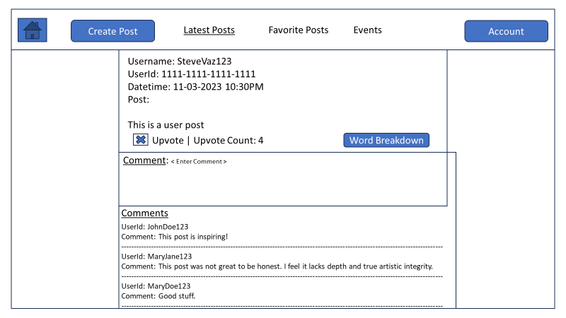
Core Features Example View

Slide 6
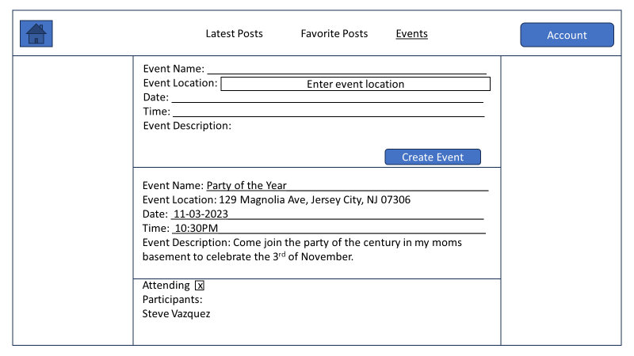
Core Features Example View

Slide 7
Extra Features
If time allows, we would like to:
Implement a password reset for the user
Add reactions to posts to increase user interaction with a post
Create a space to host most liked posts of all times
Create a follow feature to track the user’s favorite creators
Add post privacy levels to dictate who can view a post
Build feature to allow SMS text to post to site

Slide 8
What does this application bring the user?
This application gives the user access to many things including:
Sharing content in the form of text and receiving critiques and upvotes from creators alike in the form of comments. This allows the user to receive feedback on their work and interact with others.
Providing a frequency breakdown of the words used in a post give the author a quick and general understanding of the words included in the content. Sometimes authors want to prevent overusing a word, or perhaps follow a pattern with the words.
Creating and sharing literary based social events to provide, promote, and build community.
Allowing the user to display other users’ favorite pieces or the most recent content of other users. This caters to the spectator, providing an ability to store their upvoted posts.

Slide 9
Why is this project worthwhile?
This application is worthwhile because it fosters creativity, facilitates a space for creators to share, relate, evolve, and even perhaps heal. This application looks to boost up the writing community with a common love for words, while most sites cater to specific fields of writing. We believe we can corner the demand for a space where creators and word purists can thrive by offering a hotspot where creators can digitally congregate.

Slide 10



Who are my competitors?
Sites like Tumblr.com, Medium.com, AllPoetry.com, cater to artists and offer similar services but do not allow the user to create events to host social gatherings.
Perhaps the closest thing is Facebook.com, which allows content to be shared and events created, but it’s branded as a social media site. Literary purists or more focused creators may look to a more dedicated site.
This Photo by Unknown Author is licensed under CC BY
This Photo by Unknown Author is licensed under CC BY

Slide 11

Conclusion
Thank you very much on behalf of my team. We are happy to answer any follow up questions or concerns and thank you for your time!

